Slide 1

CSE 6239 Computer Vision- Januarry 2019
Human Detection and Tracking using HOG for Action
Recognition
International Conference on Computational Intelligence and Data Science (ICCIDS 2018)
Seemanthini Ka , Dr.Manjunath.S.Sb a Assistant Professor, DSATM,Bangalore and
560082,India b Professor, DSATM,Bangalore and 560082,India
CSE 6239 CV
Md. Shahidul Islam
Student ID: 1907509

Slide 2
Overview
Introduction
Existing Methodologies
Graph Based Image Segmentation
Experimental Result
Conclusion

Slide 3
Introduction
In today’s scenario human detection and tracking in video surveillance is important aspect because of the abnormal action detection.
Detecting human beings and recognizing event in a video surveillance system plays a major role in computer vision.
This research work is mainly concentrated on detection of human object and tracking to avoid the challenges involved in difficult condition.
The proposed model exhibits a new approach for the human object detection, i.e. based on Cluster segmentation approach
Page:01

Slide 4
Algorithms in this paper
Algorithm
1.Graph based image segmentation
2. SVM ( Support vector machine)
3.Histogram of oriented gradients
Page:5

Slide 5
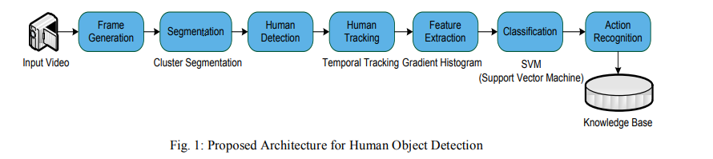
Human Detection and Tracking using HOG for Action Recognition
• Detecting human beings and recognizing actions in a video is gaining more awareness due to its broad diversity of applications
• Initially, the input video is converted into frames by frame generation block.
• The converted each video frame undergoes segmentation; here the proposed model is using Graph based segmentation to segment the objects. The main purpose of segmentation is to separate the humans from the background or other objects in the video frames.
After segmentation, the temporal tracking algorithm is used for human object detection and tracking
A standard feature extraction algorithm is i.e. histogram oriented gradient is considered for the extraction of the features in a video frame

Slide 6
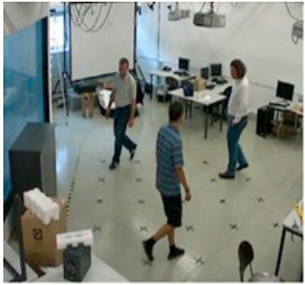
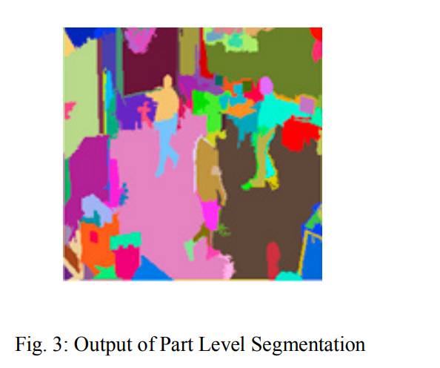
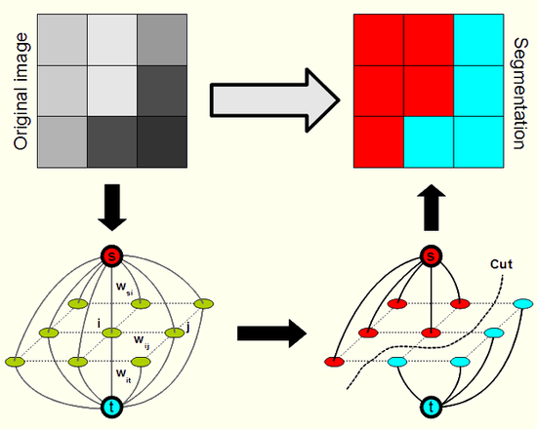
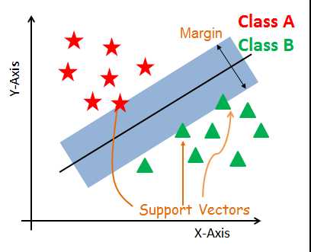
Segmentation
Hierarchical graph based segmentation is considered for the segmentation of the human object in the video frame. It contains two important levels i.e., part level and object level.
The part level segmentation is used to get colour consistent clusters on input frames. The output obtained from part level segmentation colour clusters are separated from object level segmentation.
Each cluster’s Gabor features are computed and passed to the SVM classifier. These features will be trained by SVM to classify the input clusters as human or non-human
Input First Frame
Output of Part Level
Segmentation
graph based segmentation method
Support vector mechine

Slide 7
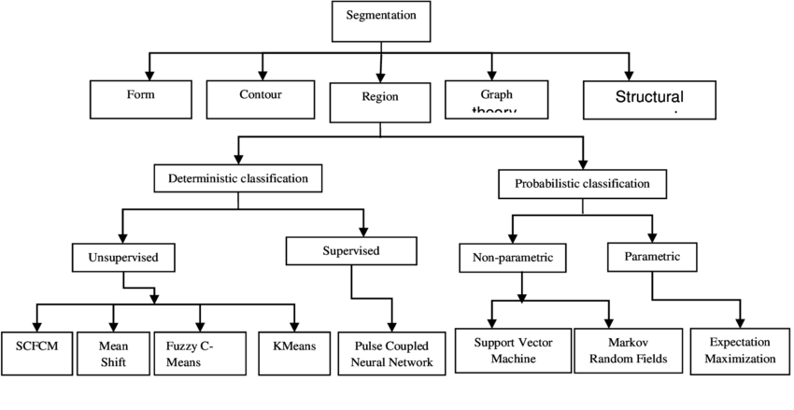
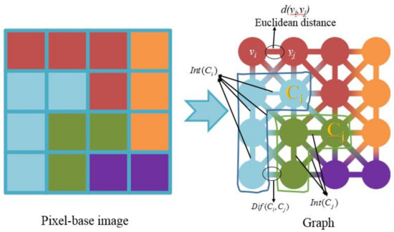
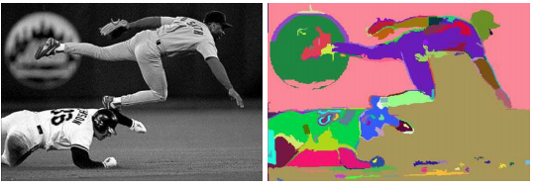
Graph based segment
For image segmentation the edge weights in the graph are based on the differences between pixel intensities, whereas for point clustering the weights are based on distances between points.
Graph based image segmentation chart
Graph based image segmentation

Slide 8
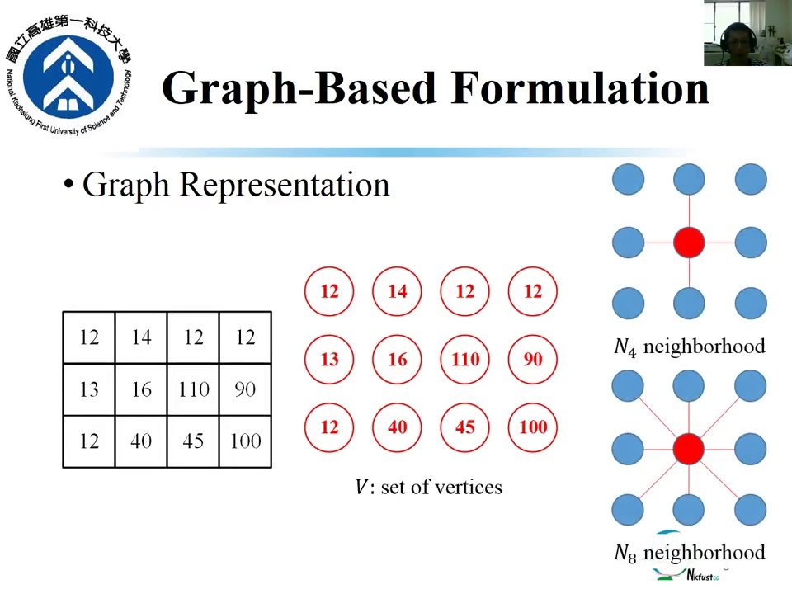
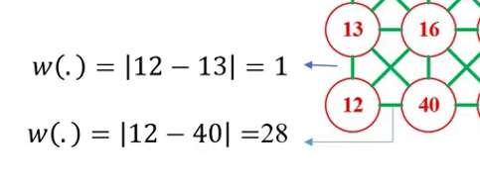
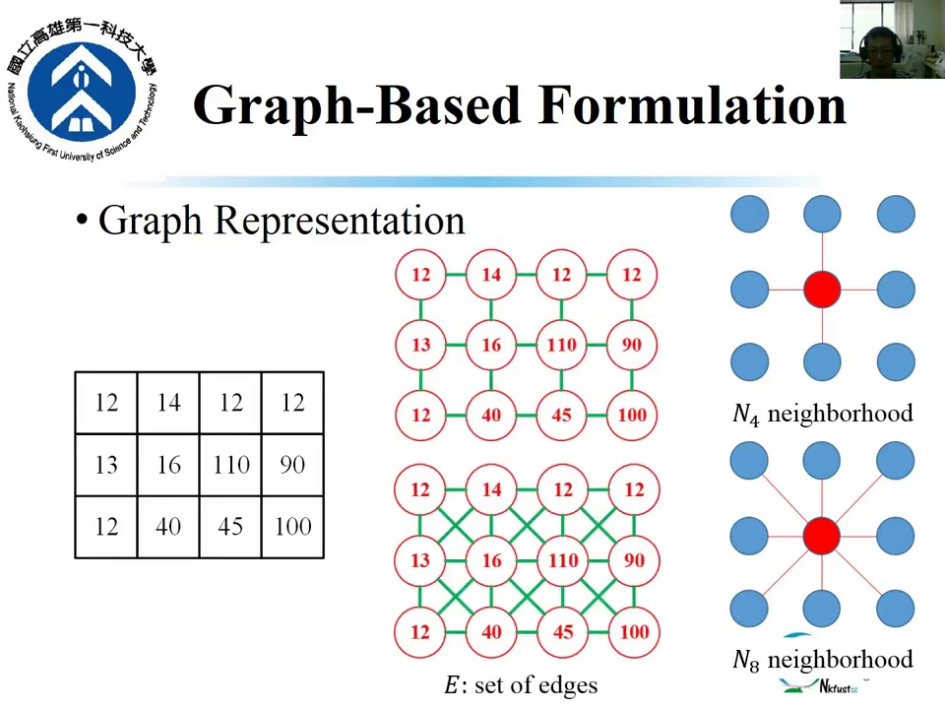
Graph based segment
Let G = (V, E) be an undirected graph with vertices vi ∈ V , the set of elements to be segmented, and edges (vi , vj ) ∈ E corresponding to pairs of neighboring vertices. Each edge (vi , vj ) ∈ E has a corresponding weight w((vi , vj )),
which is a non-negative measure of the dissimilarity between neighboring elements vi and vj .
In the case of image segmentation, the elements in V are pixels and the weight of an edge is some measure of the dissimilarity between the two pixels connected by that edge
(e.g., the difference in intensity, color, motion, location or some other local attribute).
G = (V, E)
Edge value(E) finding
N4 neighborhood
N8 neighborhood

Slide 9
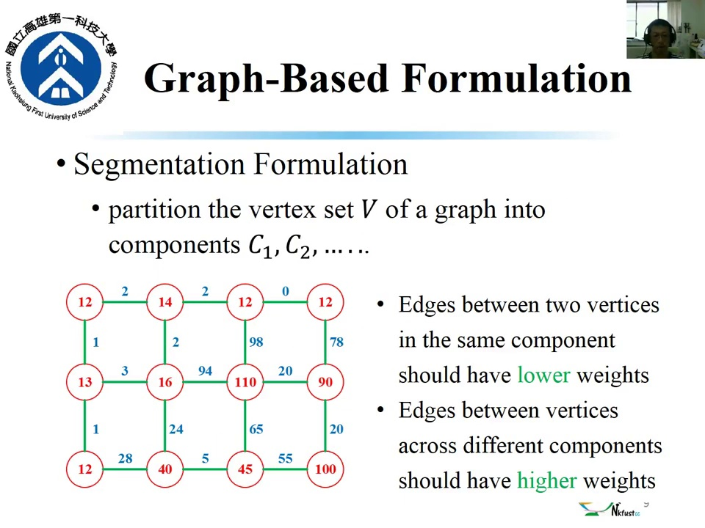
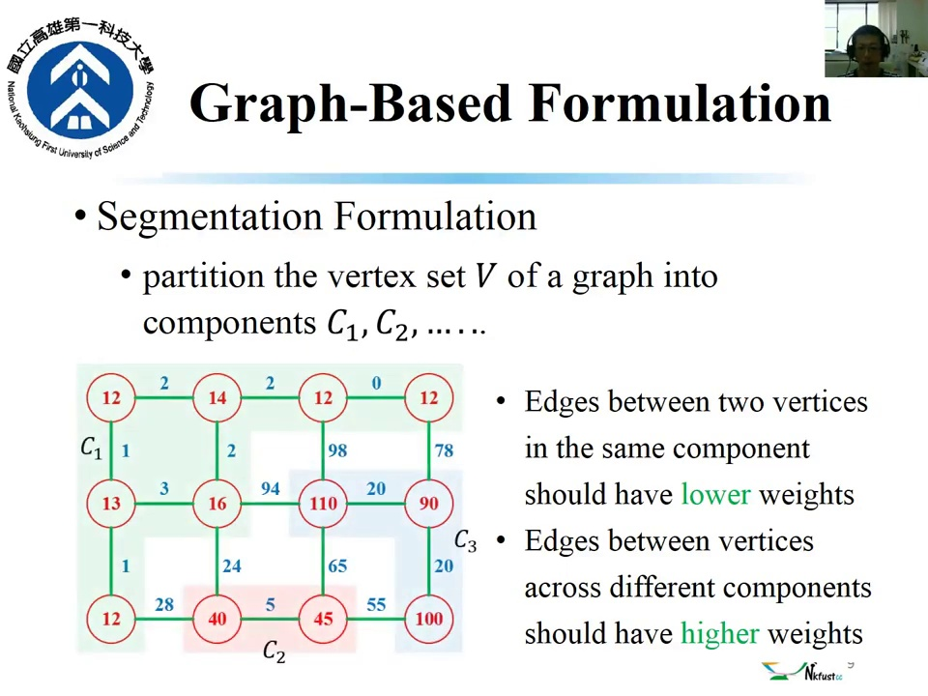
Graph based segment
Prtition the vertex set V of a graph into component C1 C2
Edge between two component shoud have lower weights.
Edge between vertices accross different components should have highrer weights.
Segmentation formulation

Slide 10
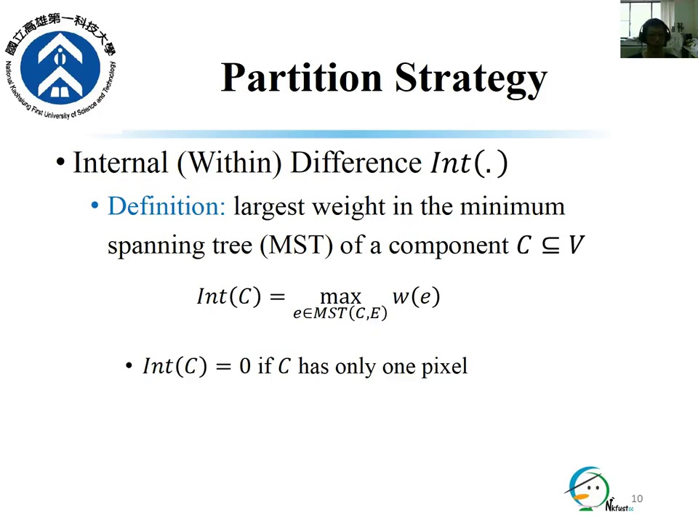
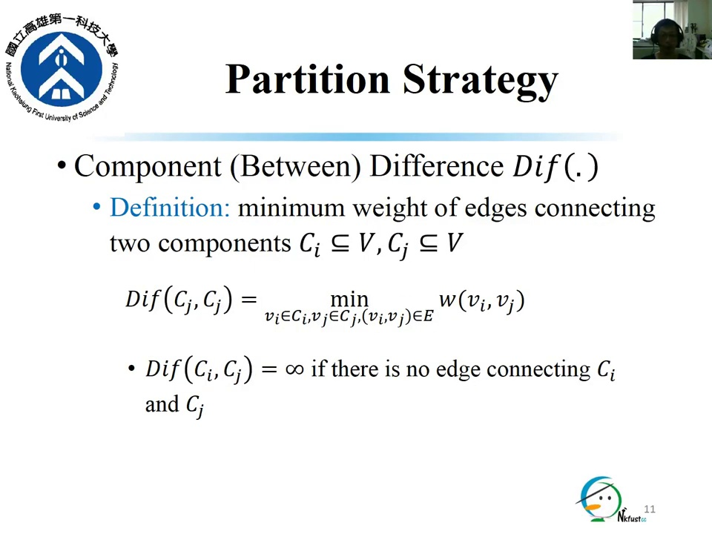
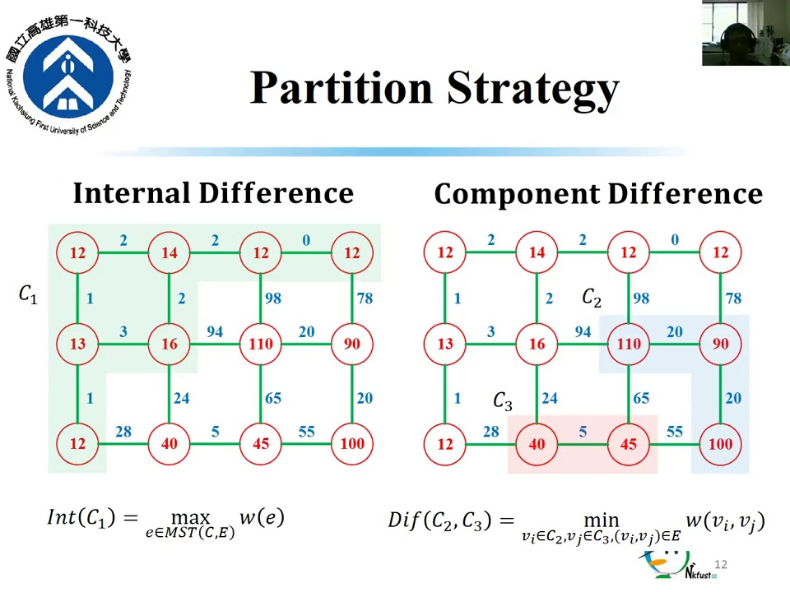
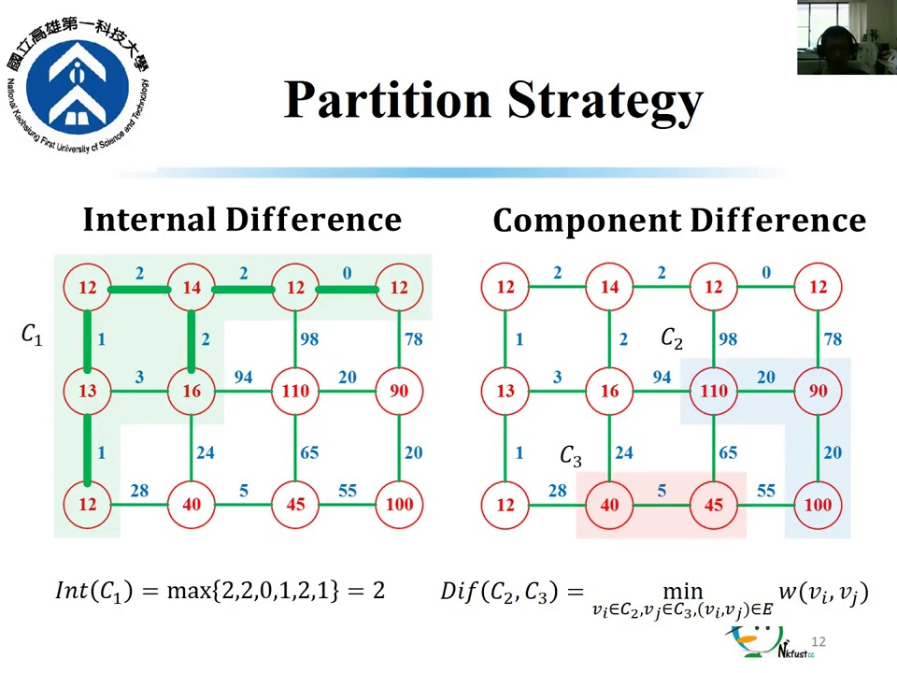
Graph based segment

Slide 11
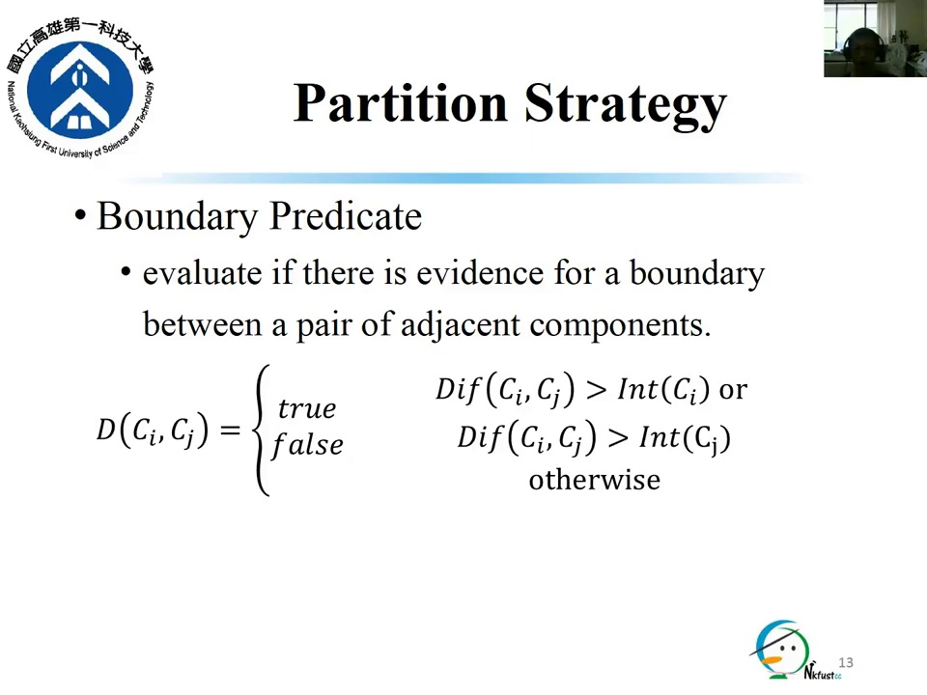
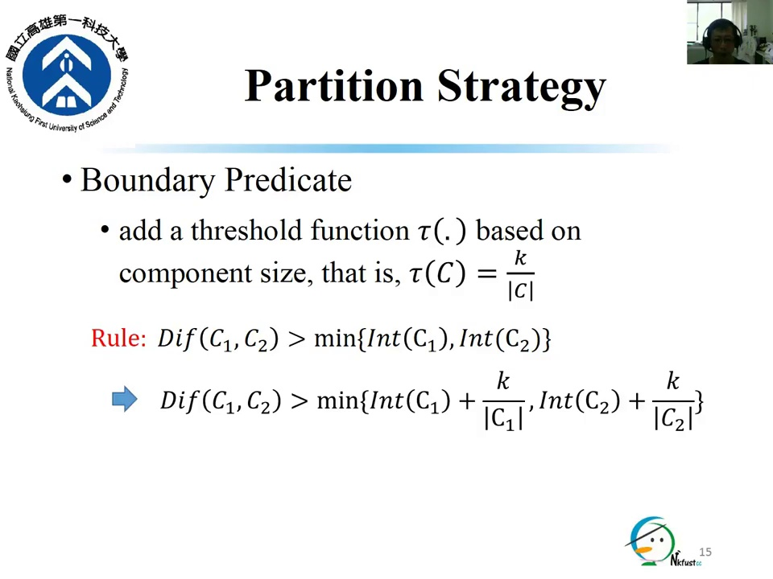
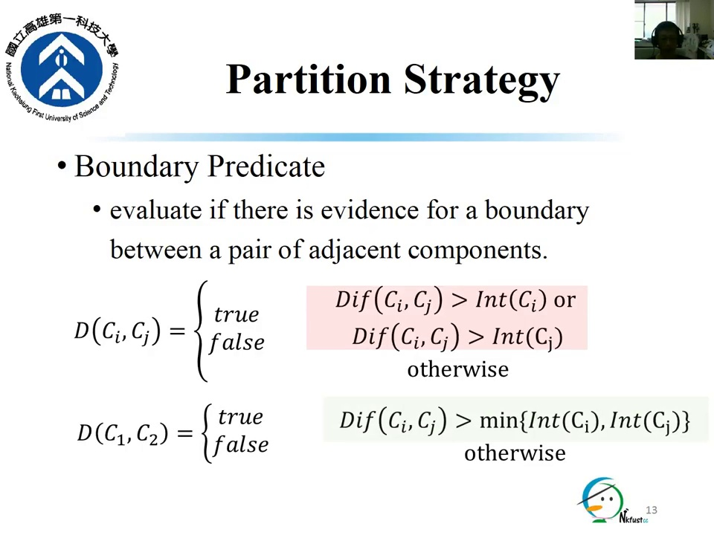
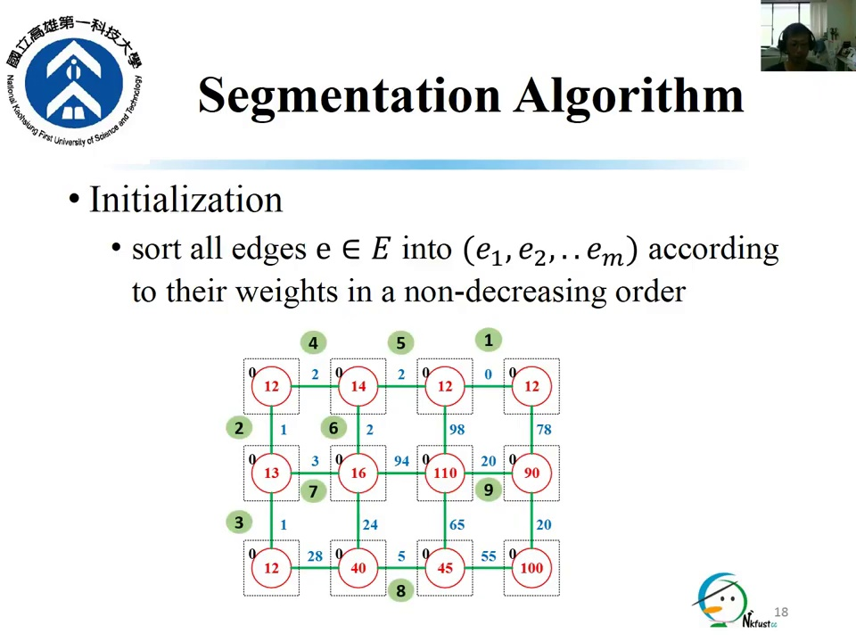
Graph based segment

Slide 12
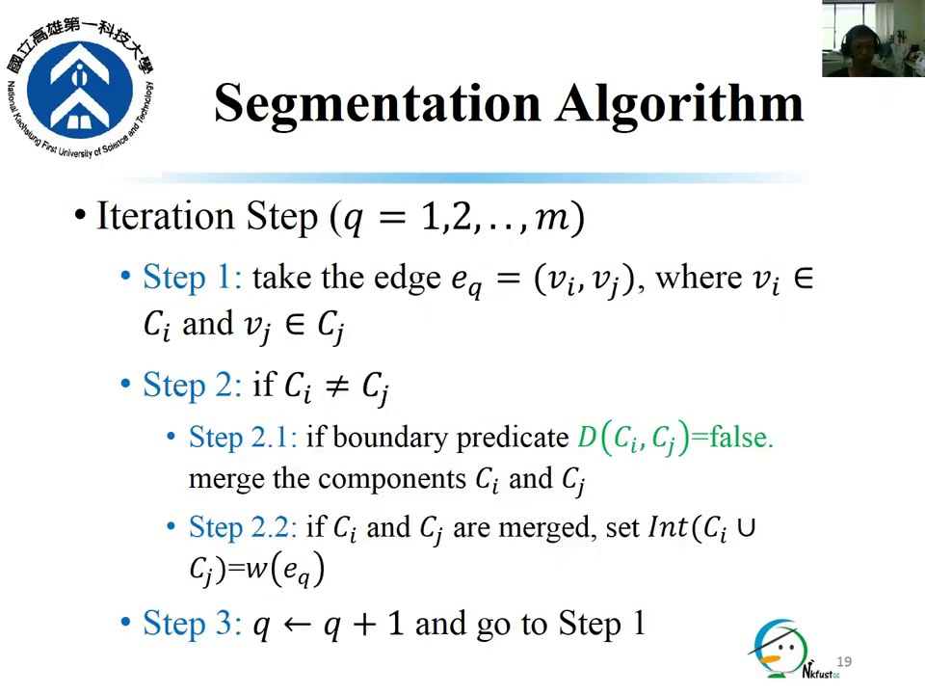
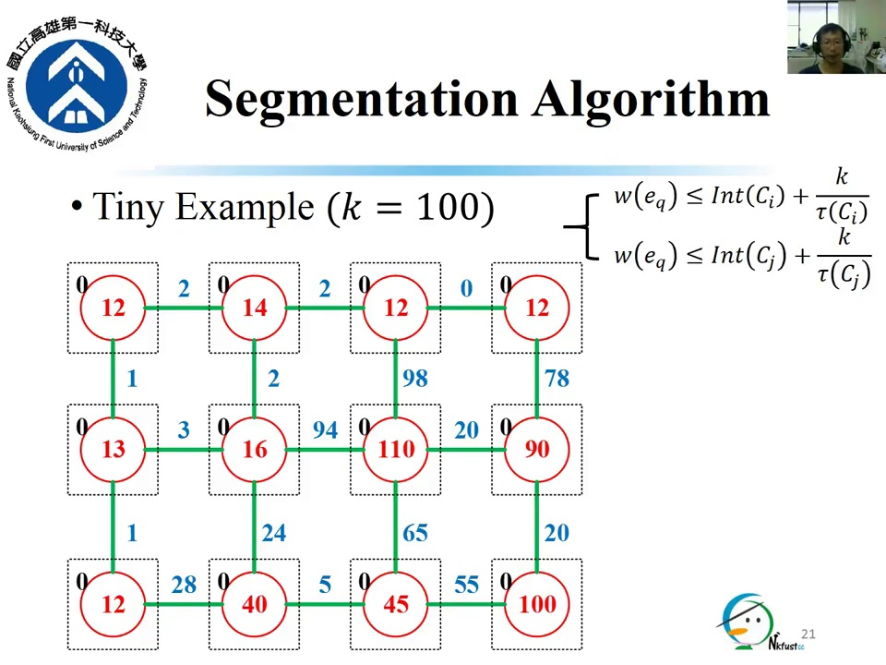
Graph based Image Segmantation algorithm
Here w(e)= weight between edge
Ci= initial value
Cj= initial value
K= highest node value(here k=100)

Slide 13
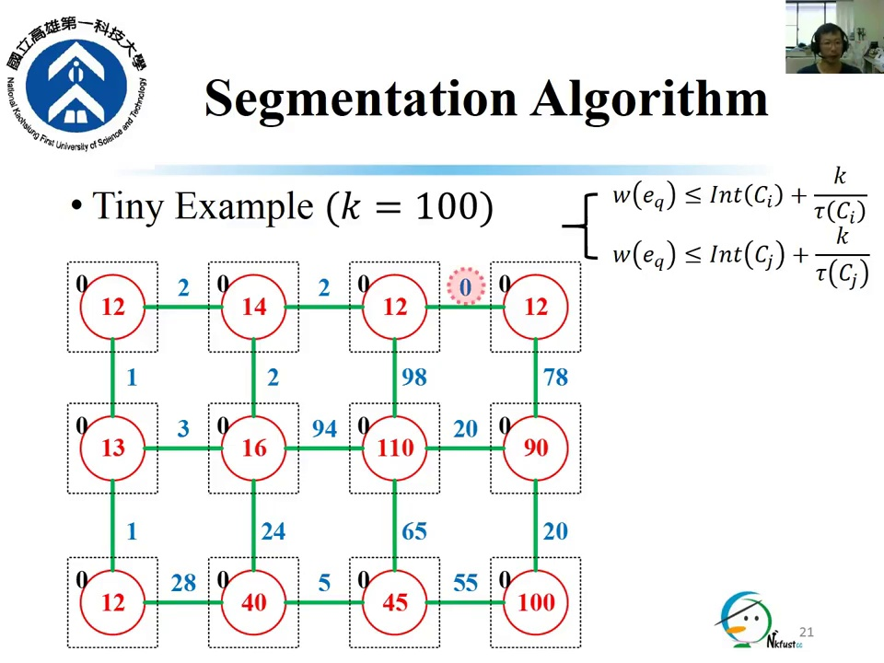

Segmantation algorithm

Slide 14
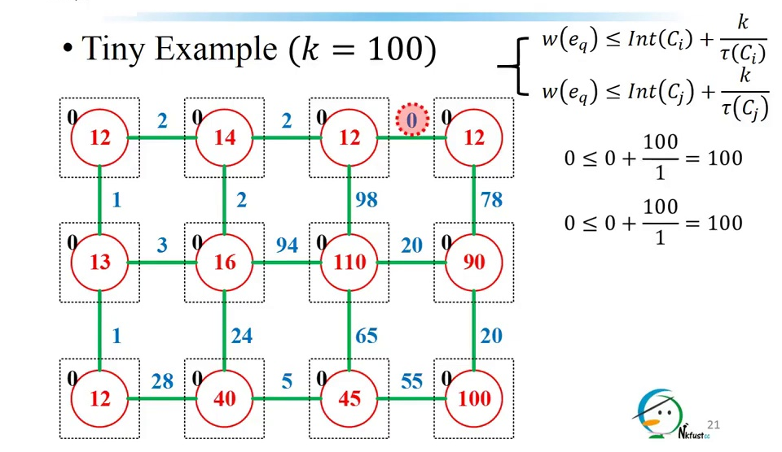
Segmantation algorithm

Slide 15
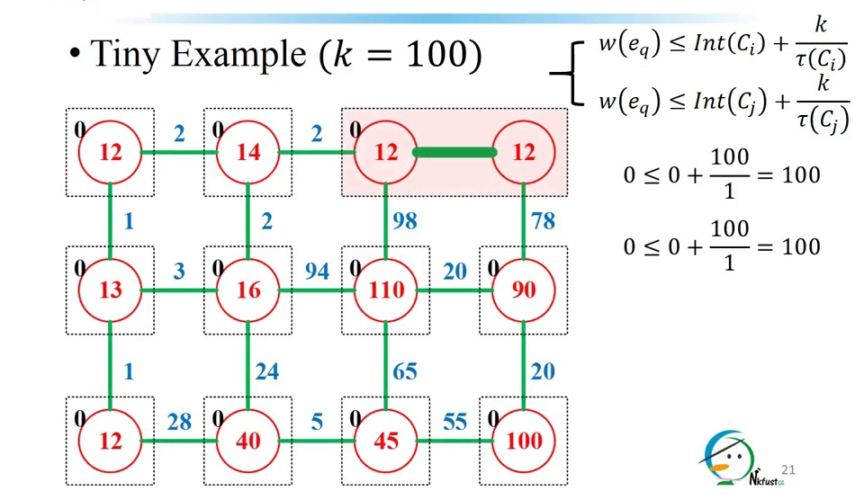
Segmantation algorithm

Slide 16
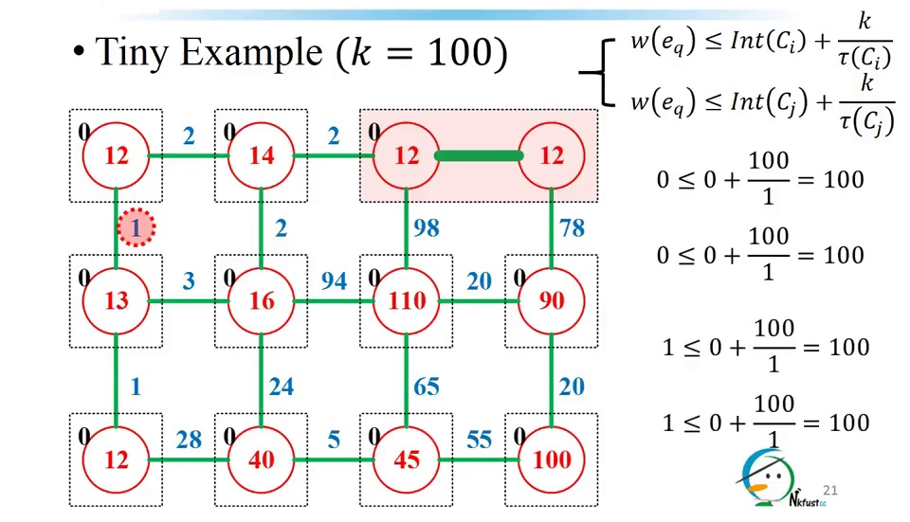
Segmantation algorithm

Slide 17
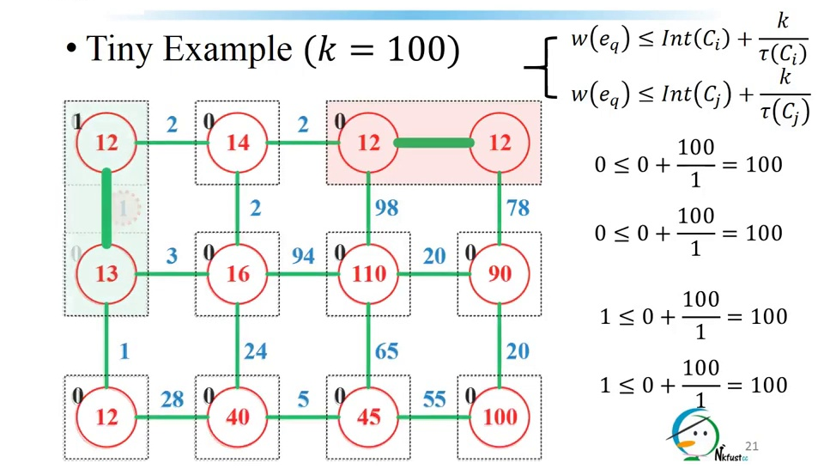
Segmantation algorithm

Slide 18
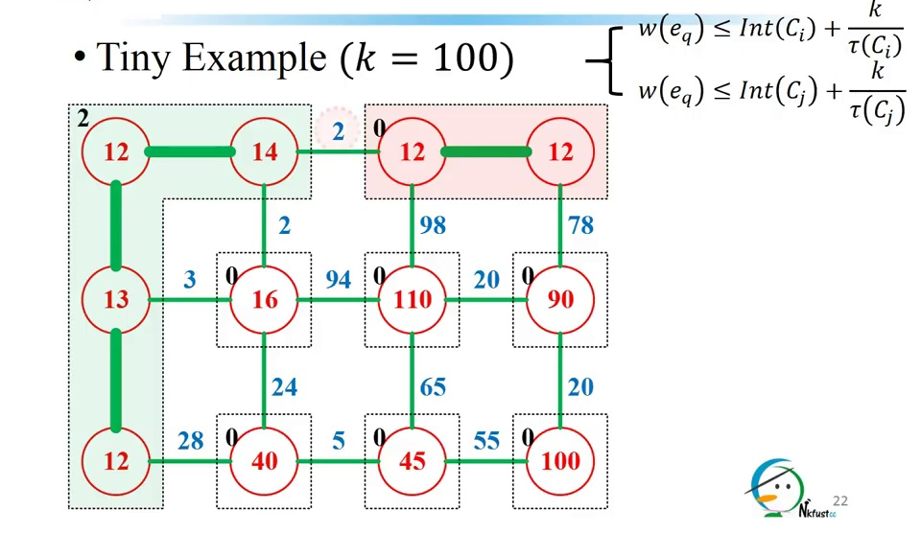
Segmantation algorithm

Slide 19
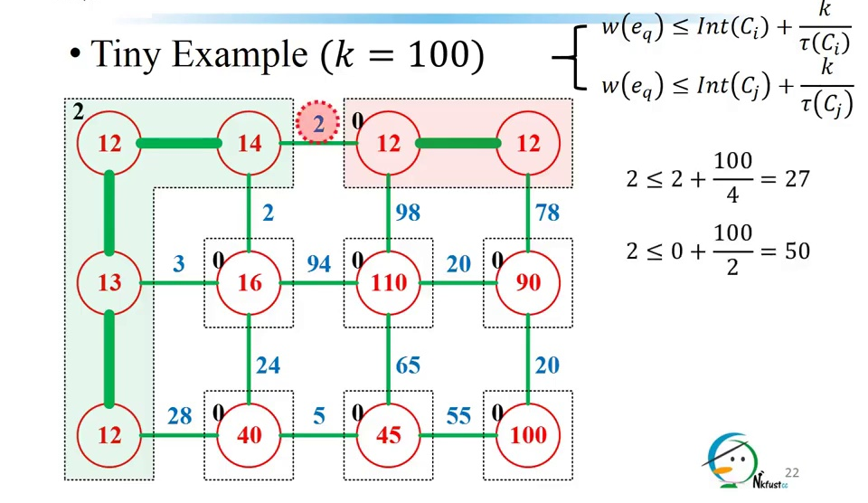
Segmantation algorithm

Slide 20
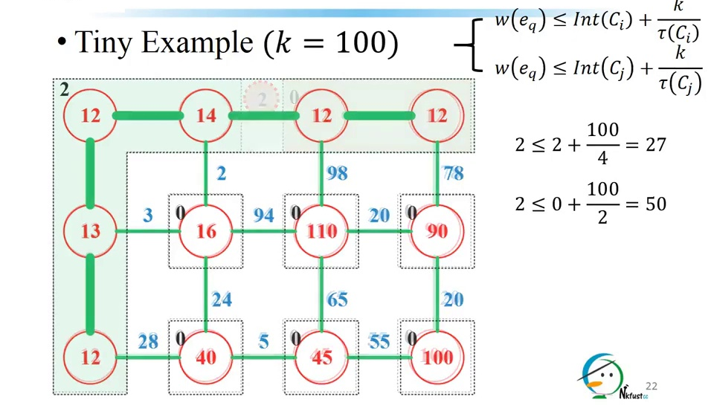
Segmantation algorithm

Slide 21
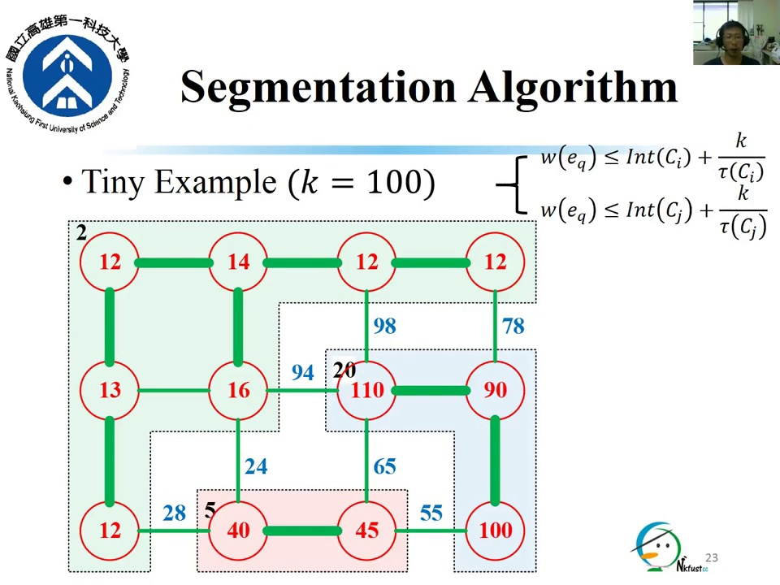
Segmantation algorithm

Slide 22
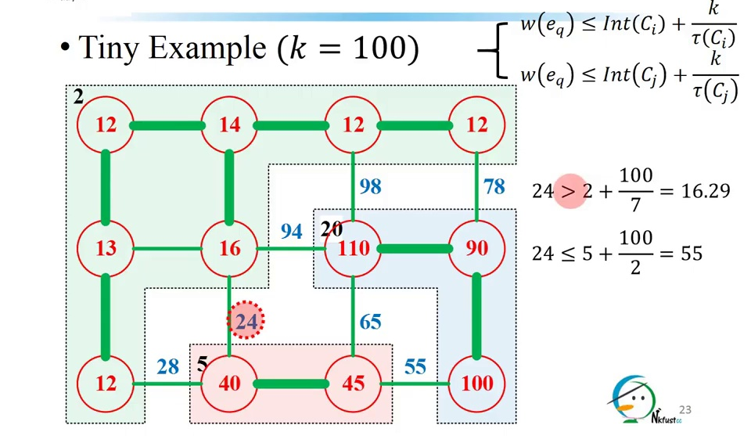
Segmantation algorithm

Slide 23
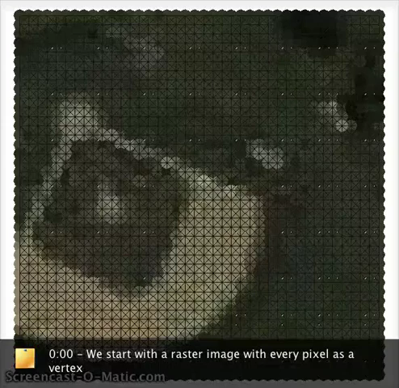
Segmantation algorithm
1.Man
2.Not man
Segmentation process
Output of Part Level
Segmentation
SVM
(support vector machine)

Slide 24
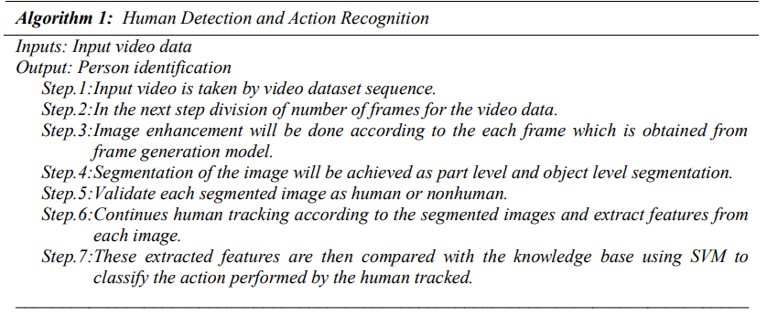
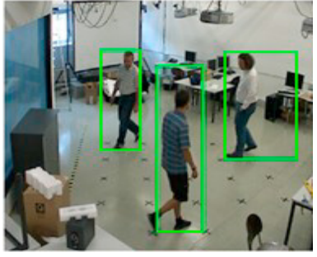
Human Tracking
Once the object is detected, next step is tracking of detected people in the corresponding successive frames.
The proposed model uses the temporal based tracking which in terms derives the rectangle around the human frame.
The main purpose of the tracking scheme is to compute the trajectories of the human objects at the consecutive frames.
Human Detected by Combining
All Human Region Clusters

Slide 25
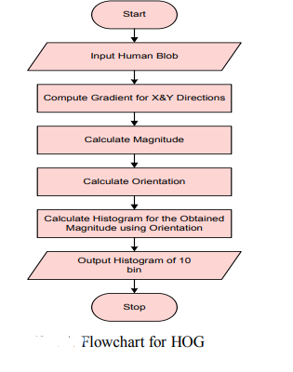
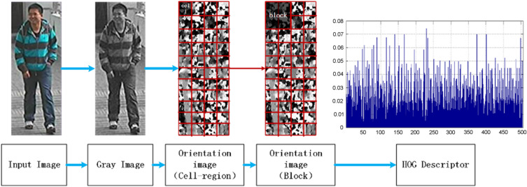
Feature Extraction and SVM Classifier
A standard feature extraction algorithm is i.e. histogram oriented gradient is considered for the extraction of the features in a video frame.
Histogram of the gradient is a feature descriptor, which is most commonly used in computer vision for object recognition.
It counts the gradient orientation occurrence in confined area of an image. Histogram gradient technique is a well known method used for the extraction of patterns.

Slide 26
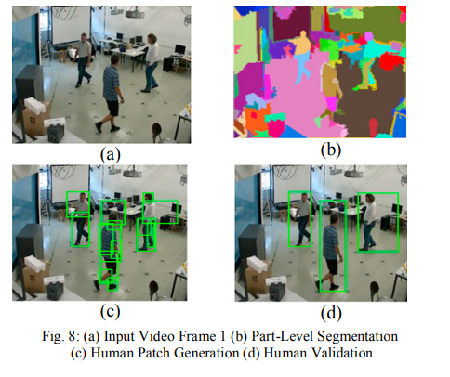
Experimental Results
The experimental result of the proposed method is discussed in this section. The video is given as an input to the system. Frames are generated, features are extracted and actions are recognized. The output video detects three to four human objects.

Slide 27
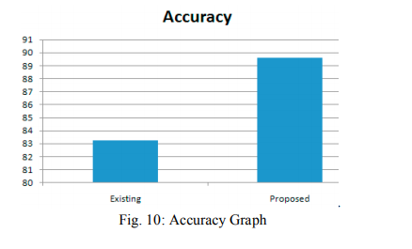
Experimental Results
depicts the tracking results obtained. The proposed model shows experimental results in terms of accuracy which is quite good compared to other existing models. Our proposed methodology shows that the accuracy is 89.59%.

Slide 28
Conclusion
The efficient approach for human action recognition system is discussed in this proposed model by using hierarchical graph based segmentation and temporal tracking approach. In contrast to existing methods this approach is capable to well discover the objects of diverse sizes and shapes, resulting to give the proficient action recognition approach. The proposed methodology achieves accuracy of 89.59%. The future enhancement can be of this work is to extend for human group detection and tracking for event detection.
Page:23

Slide 29
References
[1] Human Detection and Tracking using HOG for Action Recognition K Seemanthini, SS Manjunath - Procedia computer science, [2018]
Page:24

Slide 30
THANK YOU

